Slide 1














Phishing Awareness Training
Stay Safe, Stay Secure

Slide 2

What is Phishing?
Phishing is a cyberattack where attackers trick individuals into revealing sensitive information, such as passwords, credit card numbers, or personal data, by pretending to be a trustworthy source.

Slide 3
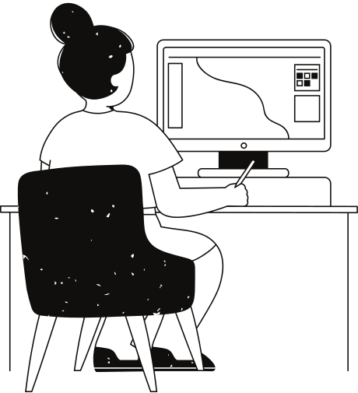
Social Engineering Tactics
What is Social Engineering?
Manipulation techniques used to exploit human behavior.
Common Tactics
Pretending to be a trusted entity
(e.g., IT support)
Creating urgency
("Reset your password immediately!")
Exploiting emotions
(fear, greed, curiosity)

Slide 4
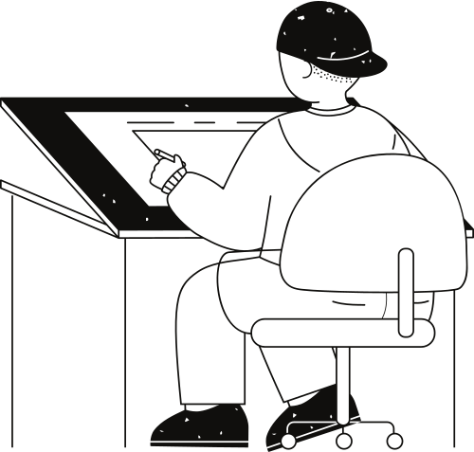
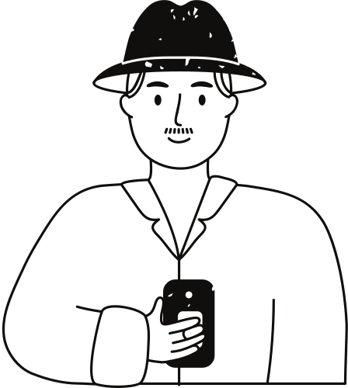



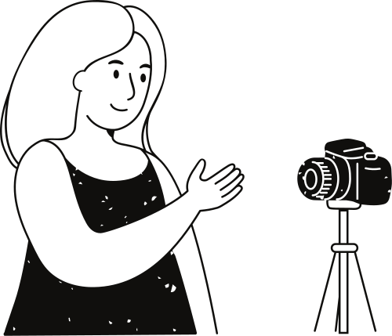
Email Phishing
Smishing
Fake emails mimicking legitimate organizations.
Phishing via SMS or messaging apps.
Types of Phishing Attacks
Spear Phishing
Vishing
Targeted attacks on specific individuals or groups.
Phishing through voice calls.
Uses social engineering to manipulate victims
Whaling
Clone Phishing
Targeting high-level executives.
Duplicating a legitimate email with malicious links.

Slide 5
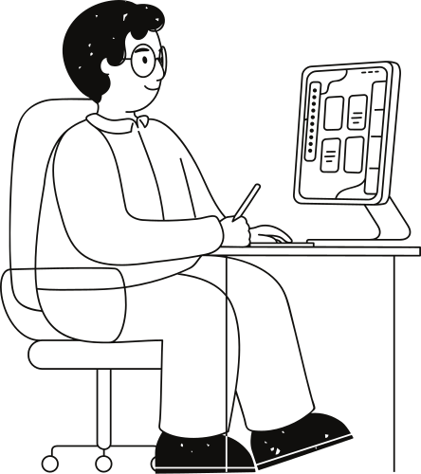
How to Recognize a
Phishing Email
Red Flags to Look For:
Suspicious sender addresses
(e.g., misspelled domains)
Urgent or threatening language ("Your account will be locked")
Unexpected attachments or links.
Generic greetings
("Dear Customer")
Requests for sensitive information.

Slide 6
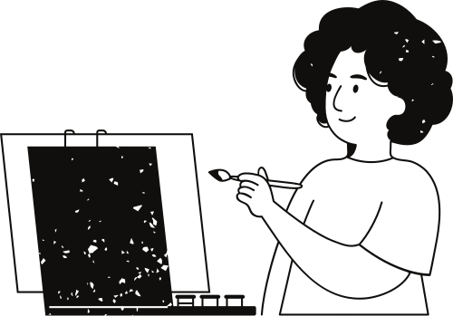
Phishing Websites
How to Spot a Fake Website
Check the URL for spelling errors or unusual domains.
Look for HTTPS (secure padlock) in the address bar.
Avoid entering personal data on websites from unsolicited links.

Slide 7
Preventive Measures
Think Before You Click
Verify the Sender
Use Strong Passwords
Keep Software Updated
Avoid clicking on suspicious links or attachments
Contact the source directly if unsure.
And enable multi-factor authentication (MFA)
Protect against vulnerabilities.

Slide 8
What to Do If You Suspect a Phishing Attack
Stay Safe, Stay Secure

Slide 9

Do Not Respond
Report It
Avoid interacting with the email or website.
Notify your organization's IT team or security department
Scan Your System
Change Passwords
Use antivirus software to check for malware
Immediately update credentials if you think they've been compromised

Slide 10
Be cautious, verify, and report
Stay Safe, Stay Secure

